Slide 1
Project - I
Team 6 :
BOOK RECOMMENDATION SYSTEM
Team Members
1.Satyajit Kadam
2.Umesh Gadhave
3.Kalpesh Patil
4.Nilesh Patil
5.Shubham Gupta
6.M Vikram

Slide 2
Why do we need a book recommendation system?
The purpose of a book recommendation system is to predict buyer's interest and recommend books to them accordingly. A book recommendation system can take into account many parameters like book content and book quality by filtering user reviews.

Slide 3
Content
Problem statement
Data Summary
Analysis of different datasets
Data Cleaning
Outlier treatment
Imputing missing values
Different Recommendation Model
Challenges
Conclusion
Future Scope

Slide 4

Problem Statement
During the last few decades, with the rise of Youtube, Amazon, Netflix, and many other such web services, recommender systems have become much more important in our lives in terms of providing highly personalized and relevant content.
The main objective is to create a recommendation system to recommend relevant books to users based on popularity and user interests.

Slide 5
Data Summary
The dataset is comprised of three csv files:: Users.csv, Books.csv, Ratings.csv
Users_dataset.
User-ID (unique for each user)
Location (contains city, state and country separated by commas)
Age Shape of Dataset - (278858, 3)
Books_dataset.
ISBN (unique for each book)
Book-Title
Book-Author
Year-Of-Publication
Publisher
Image-URL-S
Image-URL-M
Image-URL-L
Shape of Dataset - (271360, 8)
Ratings_dataset.
User-ID
ISBN
Book-Rating
Shape of Dataset - (1149780, 3)

Slide 6
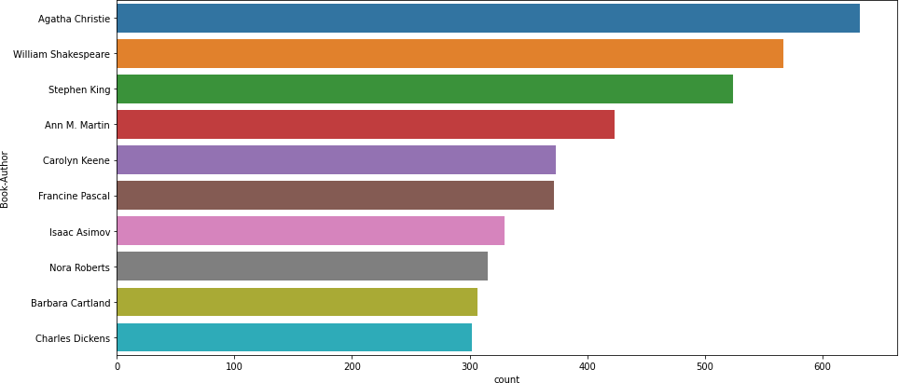
Observations from Book_df (Authors)
Agatha Christie wrote highest number of books in our given dataset

Slide 7
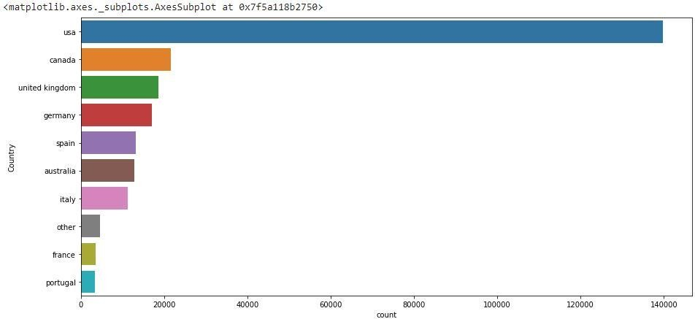
Observations from Users_df (Location)
Splitting Location column and analysing country.
Most active readers are from USA.

Slide 8
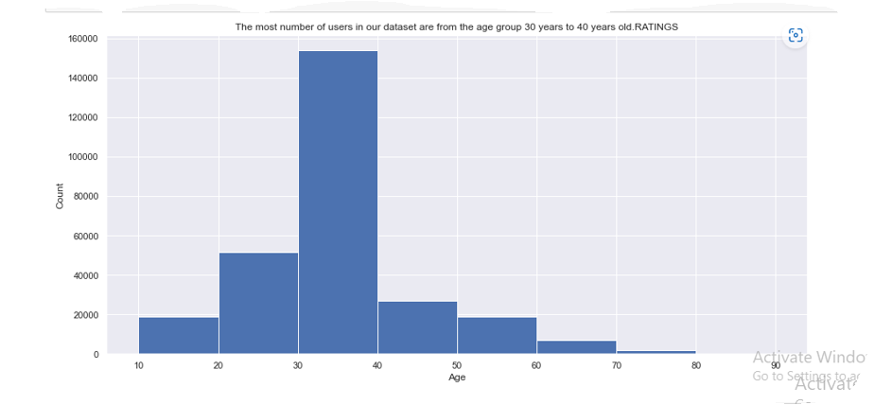
Observations from Ratings_df (Book_Rating)
The most common of users in our dataset are from the age group 30 years t 40 years years old Retings

Slide 9
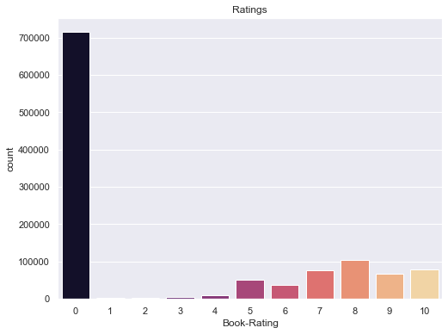
Observations from Ratings_df (Book_Rating)
Rating 8 has been rated the highest number of times

Slide 10
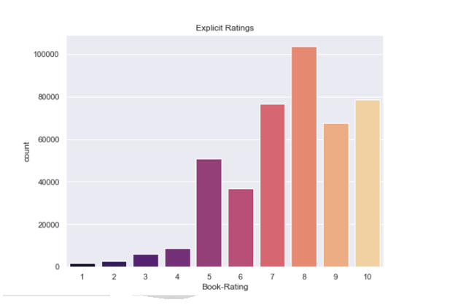
Observations from Ratings_df (Book_Rating)
Rating 8 has been rated the highest number of times

Slide 11
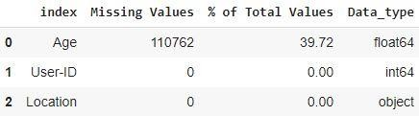
Data Cleaning
1. Null Value Imputation:
Age column has 40% missing values

Slide 12
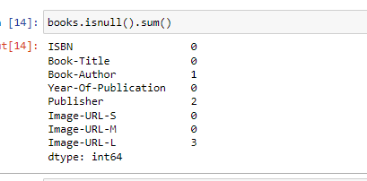
Data Cleaning
1. Null Value Imputation:

Slide 13
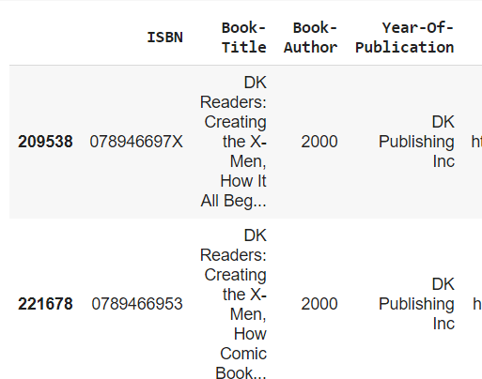
Replacing strings by int values

Slide 14
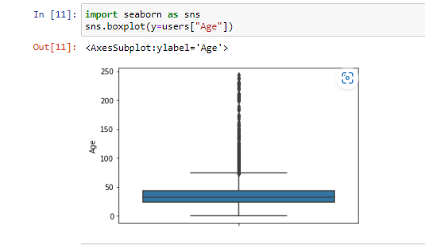
Imputing missing values
Outliers in Age column
Age has positive Skewness (right tail) so we can use median to fill Nan values,

Slide 15
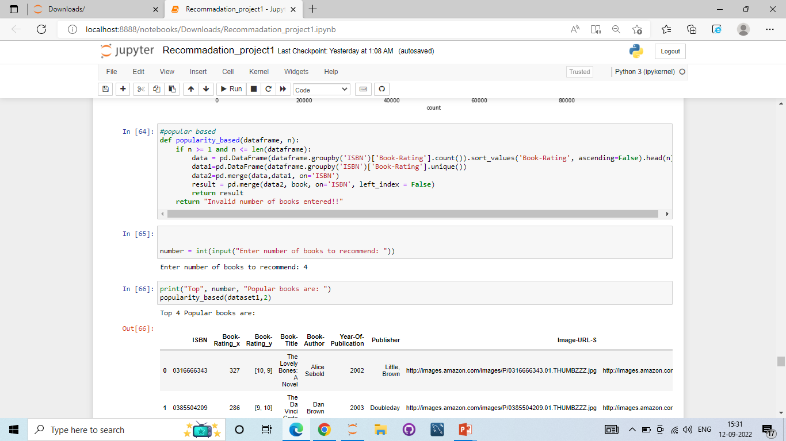
Different Models
1.)Popularity Based Recommendation
Book weighted average formula:
Weighted Rating(WR)=[vR/(v+m)]+[mC/(v+m)]
Where,
v is the number of votes for the books;
m is the minimum votes required to be listed in the chart; R is the average rating of the book; and
C is the mean vote across the whole report.

Slide 16
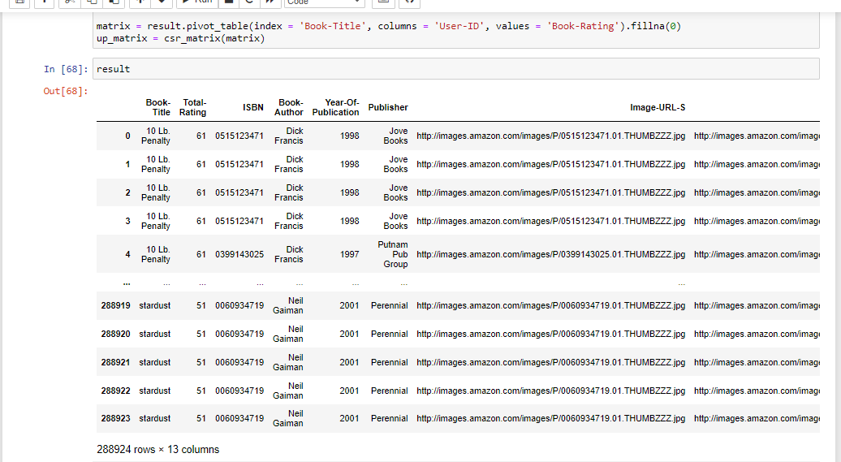
Popularity Based Models

Slide 17
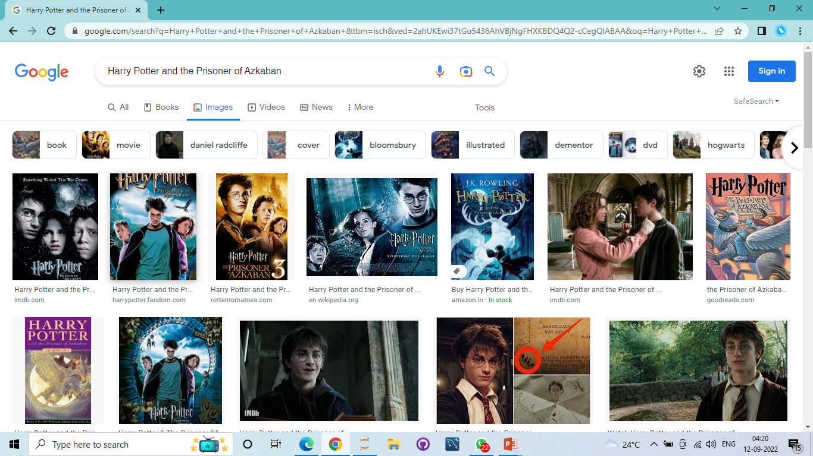
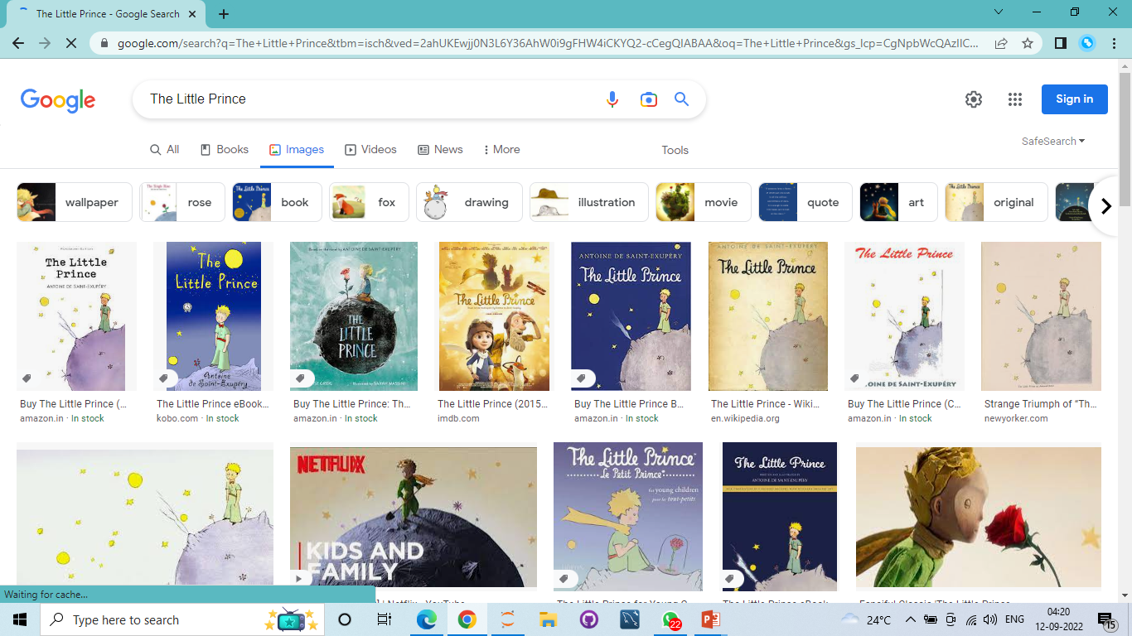
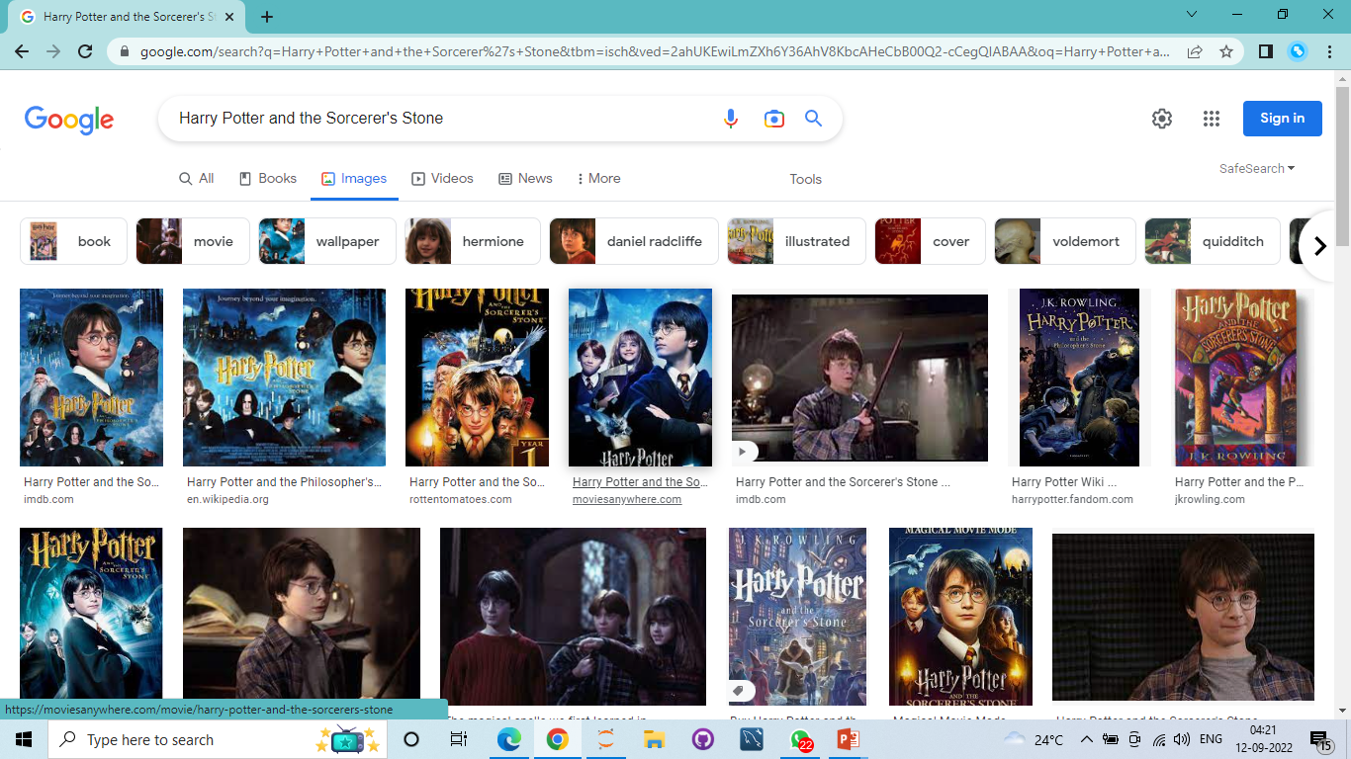
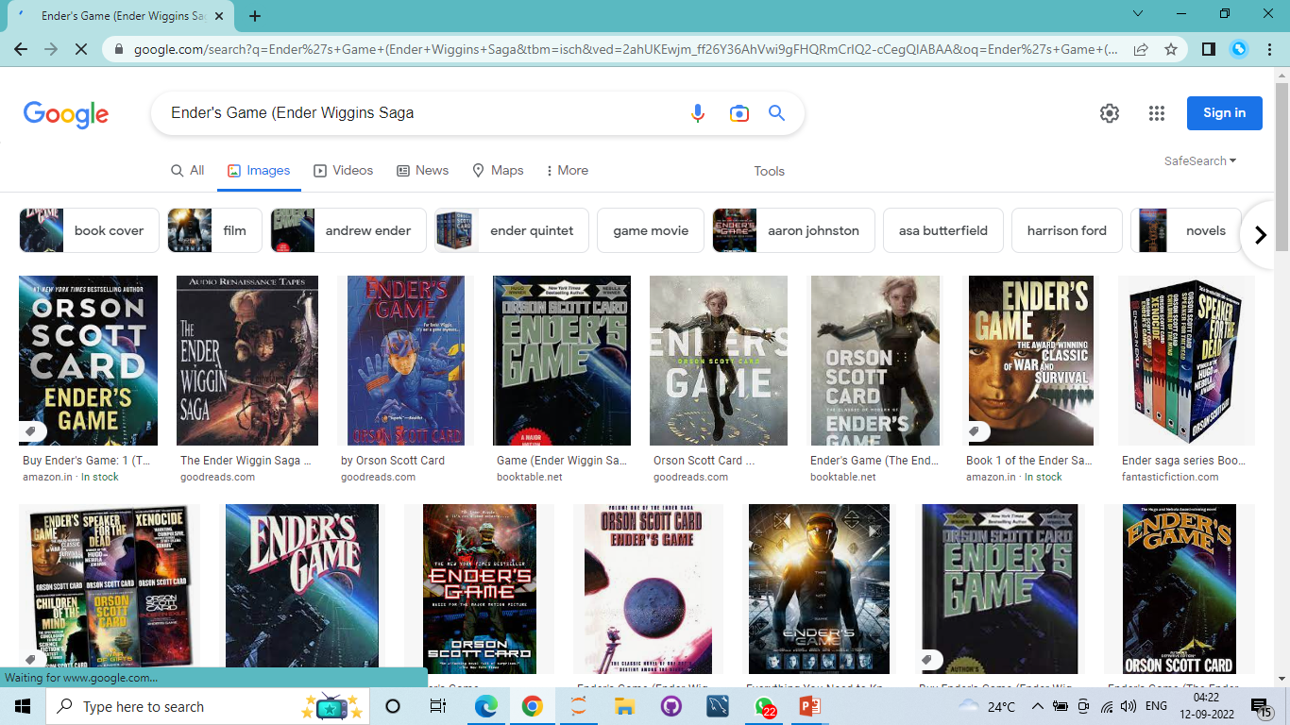
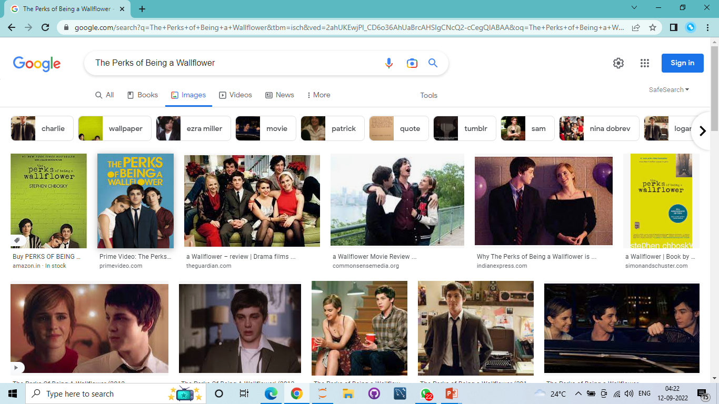
Popularity Based Models
Top rating some books

Slide 18
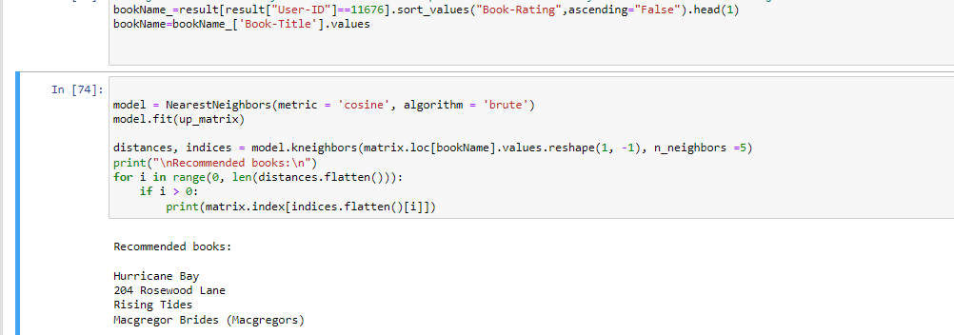
User Based Models
2.)Model based collaborative filtering
Cosine_similarity
NMF

Slide 19
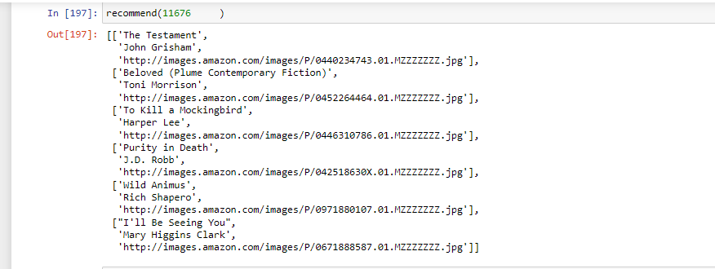
Model Results: 6 Recommend Books

Slide 20

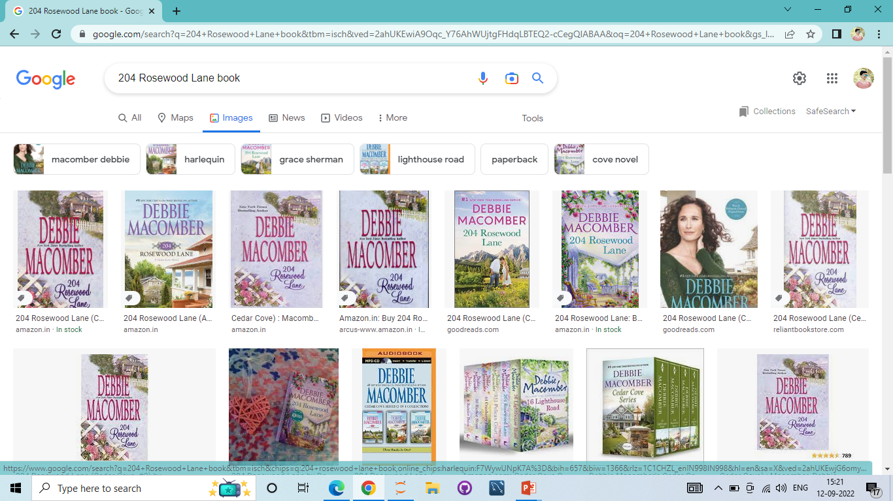
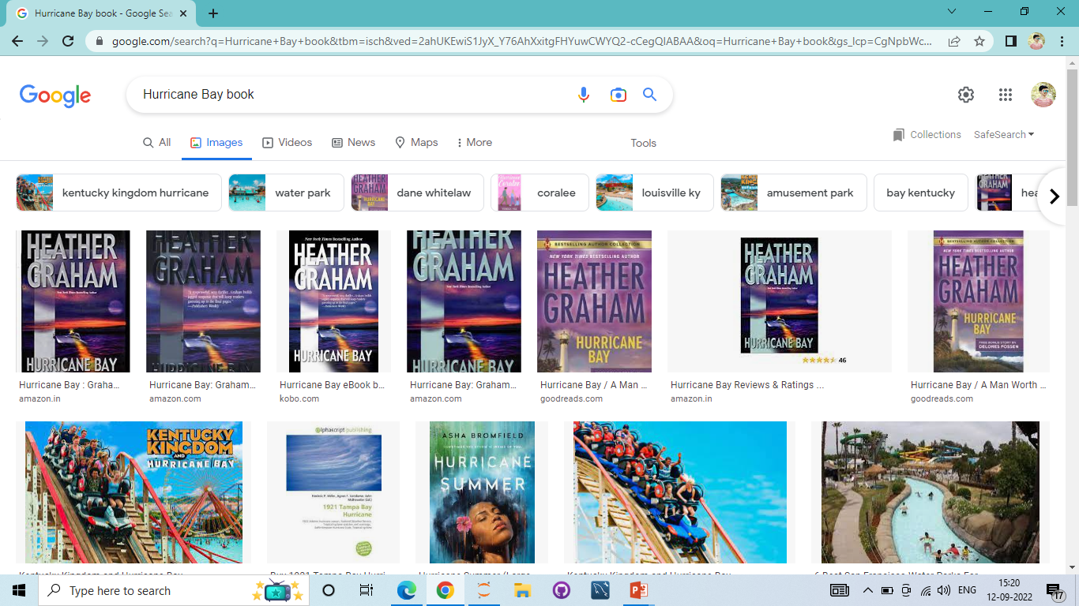
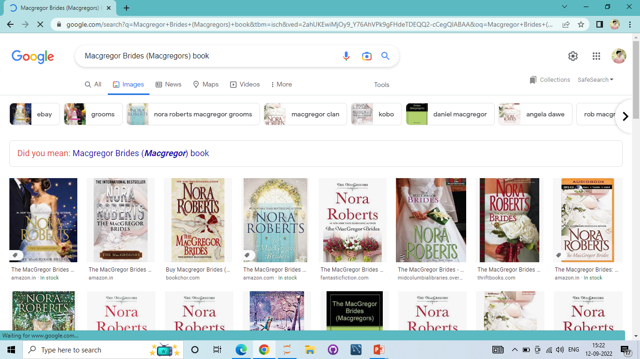
User Based Models
User-ID - 11676
Recommended: books

Slide 21
Conclusion
In EDA, the Top-10 most rated books were essentially novels. Books like The little prince and The Secret Life of Bees were very well perceived.
If we look at the ratings distribution, most of the books have high ratings with maximum books being rated 8. Ratings below 5 are few in number.
Author with the most books was Agatha Christie, William Shakespeare and Stephen King.
For modelling, it was observed that for model user based collaborative filtering technique worked .

Slide 22
Conclusion
A recommendation system helps an organization to create loyal customers. The recommendation system today are very powerful that they can handle the new customer too who has visited the site for the first time. They recommend the products which are currently trending or highly rated and they can also recommend the products which bring maximum profitto the company.
A book recommendation system is a type of recommendation system where we have to recommend similar type of books to the reader based on his interest. The books recommendation system is used by online websites which provide ebooks like google playbooks, open library, good Read’s, etc.

Slide 23
Challenges
Handling of sparsity was a major challenge as well since the user interactions were not present for the majority of the books.
Understanding the metric for evaluation was a challenge as well.
Since the data consisted of text data, data cleaning was a major challenge in features like Location etc..
Decision making on missing value imputations and outlier treatment was quite
challenging as well.

Slide 24
Future Scope
Given more information regarding the books dataset, namely features like Genre, Description etc, we could implement a content-filtering based recommendation system and compare the results with the existing collaborative-filtering based system.
We would like to explore various clustering approaches for clustering the users based on Age, Location etc., and then implement voting algorithms to recommend items to the user depending on the cluster into which it belongs.

Slide 25
Thank You

